Slide 1
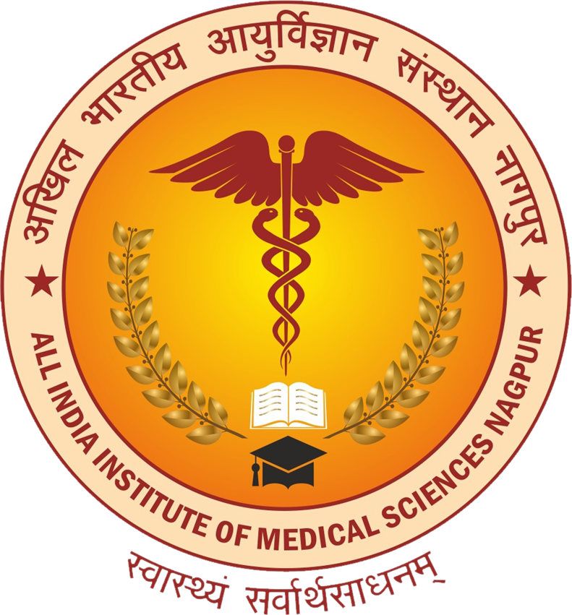
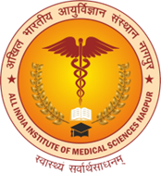
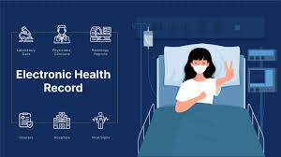
ELECTRONIC HEALTH RECORDS AND PATIENT SAFETY
Dr. Nitin Marathe
Joint Medical Superintendent cum Associate Professor
Dept. of Hospital Administration.
ALL INDIA INSTITUTE OF MEDICAL SCIENCES, NAGPUR
(An autonomous organization under the Ministry of Health & Family Welfare, Govt. of India)
Contact No: +91-7719422795
Email: drnitinmarathe@aiimsnagpur.edu.in

Slide 2
Can Electronic Health Records (EHRs) Improve Patient Safety?
Can Electronic Health Records (EHRs) Improve Patient Safety?
How Do EHRs Address Patient Safety Risks?
Are There Potential Risks with EHR Adoption?
What Are the Key Benefits and Challenges?
The Debate in Healthcare:
Proponents -EHRs are critical for improving patient safety.
Critics -risks such as system failures or errors introduced by improper implementation.
Notes:
Adoption of EHR is still in the early stages in India, with significant disparities between urban and rural areas.Urban Areas: Higher adoption in private healthcare institutions, advanced diagnostic centers, and corporate hospitals.Rural Areas: Limited adoption due to challenges like poor internet connectivity, low digital literacy, and infrastructure gaps.Government Initiatives: The National Digital Health Mission (NDHM) and Ayushman Bharat Digital Mission (ABDM) are key drivers of EHR adoption in India.Challenges: Lack of standardization, data priCan Electronic Health Records (EHRs) Improve Patient Safety?
How Do EHRs Address Patient Safety Risks?
Are There Potential Risks with EHR Adoption? priCan Electronic Health Records (EHRs) Improve Patient Safety?
How Do EHRs Address Patient Safety Risks?
Are There Potential Risks with EHR Adoption?
What Are the Key Benefits and Challenges?
The Debate in Healthcare:
Proponents -EHRs are critical for improving patient safety.
Critics -risks such as system failures or errors introduced by improper implementation
vacy concerns, and a slow transition from paper-based records.
What Are the Key Benefits and Challenges?
The Debate in Healthcare:
Proponents -EHRs are critical for improving patient safety.
Critics -risks such as system failures or errors introduced by improper implementation
vacy concerns, and a slow transition from paper-based records.

Slide 3

Brief Outline- EHRs & PATIENT SAFETY
1.Introduction
2.EHRs Enhancing Patient Safety
3.Challenges in EHR Usability & Patient Safety
4.Case Scenario -Impact of EHR Gaps and Improvements on Patient Safety
5.ABDM (Ayushman Bharat Digital Mission ) and its Relevance to Patient Safety
6.Challenges in the Current EHR and Patient Safety Scenario & ABDM Ecosystem
7.Implementing Patient Safety through Electronic Health Records (EHR) in Hospitals
8.Strategies for Optimizing EHRs for Patient Safety
9.Research Needs in EHR and Patient Safety
10.Conclusion

Slide 4
Electronic Health Records and Patient Safety
Introduction
What are Electronic Health Records (EHRs)?
Digital systems used to store a patient’s medical information, including their medical history, diagnoses, medications, test results, and treatment plans.
Patient safety refers to practices that prevent harm to patients during the course of medical care. It ensures that the care provided is safe, effective, and free from errors.
Linkage Between EHRs and Patient Safety
Improving patient safety by providing more accurate, accessible, and coordinated care.
However, they also introduce new challenges that can impact patient safety if not used properly.
What is Patient Safety?
Components include:
Clinical Data Repository (CDR)
Computerized Provider Order Entry (CPOE)
Physician Documentation (PD)
Facilitates real-time, patient-centered, and data-driven care.
Core Benefits:-Medication Safety-Diagnostic Accuracy, Streamlined Communication, Data Centralization:
Clinical Decision Support System (CDSS)
Notes:
Core Benefits:Medication Safety: Reduces prescription errors with alerts and decision support.
Diagnostic Accuracy: Identifies missed diagnoses and aids clinical decision-making.
Streamlined Communication: Enhances care transitions and handoffs.
Data Centralization: Enables comprehensive patient records for continuity of care.

Slide 5
How EHRs Enhance Patient Safety
Improved Access to Comprehensive Patient Information
Real-time access to critical patient data (medications, medical history, lab results).
Accurate and complete information helps clinicians make informed, timely decisions and avoid errors.
Reduction in Medication Errors
E-Prescribing & Alerts: Minimizes errors due to illegible handwriting and automatically alerts for drug interactions.
Automated Dosing: Recommends safe dosages based on patient-specific metrics, reducing manual errors.
Clinical Decision Support Systems (CDSS)
Preventive Care Reminders: Ensures timely reminders for screenings, vaccinations, and preventive services.
Diagnostic Support: Helps reduce diagnostic errors by guiding clinicians with evidence-based protocols.
Enhanced Coordination of Care
Interoperability: Facilitates data exchange across providers and healthcare facilities, ensuring continuity.
Continuity of Care: Reduces information loss during transitions of care (e.g., hospital to home, or specialist to primary care).
Patient Safety Analytics
Data Analysis: Analyzes EHR data to identify trends (e.g., adverse events) and inform quality improvement.
Predictive Analytics: Uses data to predict high-risk patients, enabling early intervention and prevention of complications.
Patient Engagement
Patient Portals: Provides access to health data, allowing patients to engage actively and identify potential errors in their own records.
Shared Decision-Making: Encourages informed patient participation, improving the overall safety of care through better communication.

Slide 6
Challenges in EHR Usability and Patient Safety
Poor Usability of EHRs
Complex interfaces and inefficient workflows hinder clinician productivity.
Distracting alerts and notifications reduce decision-making efficiency.
Link Between Usability and Safety
Difficult-to-use systems perform poorly in safety evaluations.
Reduced ability to catch harmful medical errors like drug interactions, allergies, and dosing issues.
Lack of Standardization
No universal standards for EHR usability or safety performance.
Customization by hospitals can compromise system integrity and safety.
Quality Control Gaps
Hospitals often overlook regular safety testing for EHR systems.
Assumptions about inherent safety of EHRs can lead to overlooked vulnerabilities.
Need for Collaborative Improvement
Collaboration between EHR vendors, hospitals, and clinicians is necessary.
Focus on optimizing usability and integrating safety measures.
Alert Fatigue
Excessive or irrelevant alerts desensitize clinicians, leading to missed critical notifications.
Data Fragmentation
Lack of interoperability hampers seamless sharing of patient information.
Disjointed data can lead to incomplete records and unsafe care decisions.
Over-Reliance on Automation
Clinicians may depend too much on automated systems, overlooking critical judgment calls.
Inadequate Training
Limited training increases user errors, especially during transitions or updates.
Cost and Resource Barriers
High costs deter smaller hospitals from implementing safety improvements.
User Dissatisfaction
Negative experiences with EHRs lead to burnout and reduced focus on patient care.
Privacy and Security Risks Cybersecurity
Vulnerabilities in EHRs can lead to data breaches, compromising patient trust and safety.
Notes:
Various “Alert fatigue has contributed to various adverse outcomes and is considered a significant patient safety hazard.”

Slide 7

Case Scenario -Impact of EHR Gaps and Improvements on Patient Safety
Case Scenario: Elective Gallbladder Surgery
A 45-year-old male patient is scheduled for elective gallbladder surgery due to chronic gallstones. The patient has heart disease, which is not updated in the EHR.
Aspect
Preoperative Review
Communication Between Providers
Risk Identification and Management
Decision-Making
Postoperative Monitoring
Overall Patient Safety Outcome
Potential Risks in Patient Safety (Due to EHR Challenges)
Outdated EHR: The surgeon reviews the old EHR, which does not include the updated diagnosis of heart disease. This oversight results in inadequate preparation for potential cardiac risks during surgery.
Missed communication: The heart disease update is sent via paper records that are not integrated into the EHR system in time, leading to a delay in the surgeon receiving the full clinical picture.
No alert or flag for cardiac concerns in the EHR. The surgeon is unaware of the patient’s condition, possibly leading to increased risk of complications during surgery (e.g., anesthesia or heart failure).
The lack of complete information in the EHR may lead to poor decision-making, such as proceeding with surgery without adjusting the plan for cardiac risks. This increases the chance of intraoperative complications.
Without cardiac updates, the patient may not receive the necessary monitoring for heart issues after surgery, which can lead to unnoticed complications
The patient is at higher risk for complications (e.g., heart attack, poor recovery) due to missing critical information in the EHR. This can result in delayed recovery or worsened outcomes.
How EHR Improves Patient Safety (When Used Effectively)
The surgeon reviews the complete, up-to-date EHR, which includes the patient's heart disease and the need for cardiac clearance before surgery. This ensures proper risk management and appropriate preoperative testing.
Real-time EHR updates allow seamless communication between providers, ensuring that the surgeon receives the most current and complete information, including the heart condition, to inform the surgical plan.
EHR alerts and flags notify the surgeon about critical health conditions like heart disease, prompting timely interventions (e.g., adjustments to anesthesia) and proper postoperative care.
With updated and comprehensive EHR data, the surgeon can make informed decisions, adjusting the surgical plan or preparing for potential complications, thus ensuring safer surgery and optimal care.
The updated EHR ensures continuous postoperative monitoring. If any cardiac issues arise, the care team can intervene promptly, reducing the risk of serious complications.
The patient undergoes a safer surgery with timely preoperative testing, adequate risk management, and effective postoperative monitoring, leading to a faster recovery and better overall outcome.

Slide 8

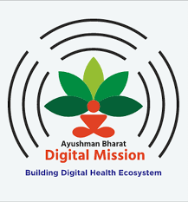
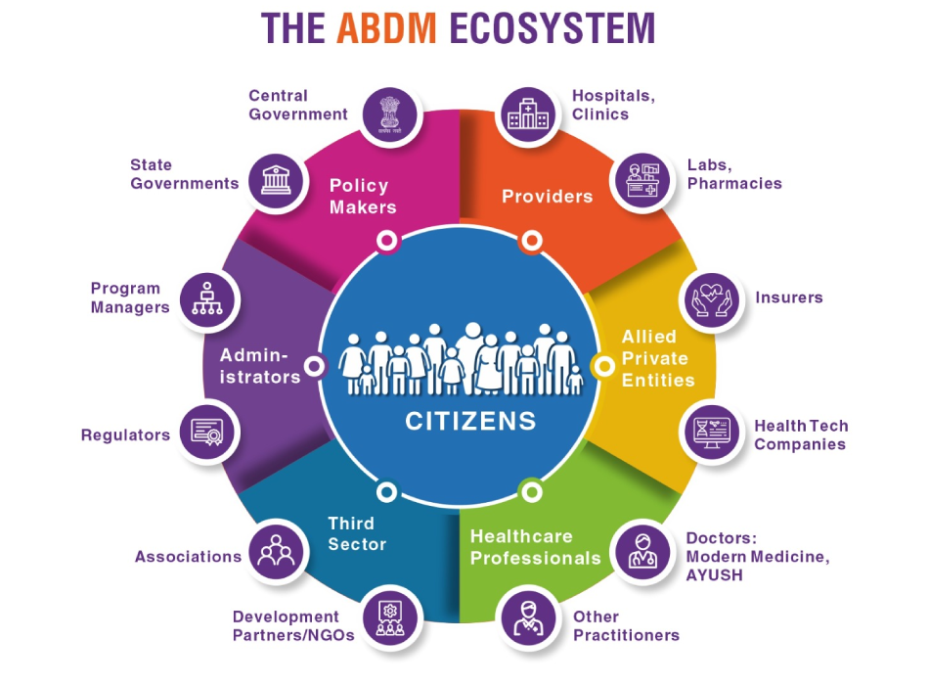
ABDM (Ayushman Bharat Digital Mission ) and its Relevance to Patient Safety
ABDM Feature | Impact on Patient Safety
Unique Health ID (UHID) | Ensures accurate identification of patients
Healthcare Professionals Registry (HPR) | Provides access to verified healthcare professionals, reducing risks associated with unqualified practitioners.
Healthcare Facilities Registry (HFR) | Helps patients choose certified facilities, ensuring access to quality healthcare services and reducing risks of substandard care.
Personal Health Record (PHR) System | Empowers patients to access and share their health data securely, preventing errors from incomplete or missing medical history during treatment.
Interoperability (FHIR) Fast Healthcare Interoperability Resources | Enables seamless sharing of medical data across systems, ensuring continuity of care and preventing errors caused by fragmented records.
Health Information Exchange Consent Manager (HIE-CM) | Manages user consent for health data sharing, ensuring secure and authorized exchange of personal health information. Prevents unauthorized access and promotes safe data usage
National Health Stack (NHS) | Digital health infrastructure ensures reliable and real-time access to critical patient information, aiding quick and informed decision-making.
Digital Consent Framework | Protects patient privacy, ensuring only authorized access to sensitive health data, fostering trust and preventing misuse.
e-Sanjeevani Telemedicine Services | Offers remote consultations with accurate patient data, reducing delays and enhancing safety for patients in remote or underserved areas.
National Health Claims Exchange (HCX) | Streamlines insurance processes, reducing administrative delays that could impact timely treatment and patient outcomes.
Focus on Data Privacy and Security | Protects against data breaches and misuse, reducing risks of identity theft or fraudulent use of health records that might compromise patient safety.
Public and Private Sector Participation | Enhances the scope and quality of healthcare services, ensuring safer and standardized care delivery across public and private institutions.
Notes:
ABDM’s digital framework improves patient safety by ensuring accurate, accessible, and real-time information, reducing errors and enhancing coordination across healthcare providers. In ABDM FHR network, Health Information is interchanged using HL7 FHIR as data formats, which addresses the syntatic interoperability by providing a machine readable wire format. Addressing needs of Semantic interoperability can be achieved by adopting a common terminology / coding standards. Examples of such standards are SNOMED-CT, ICD10, LOINC etc. National Resource Centre for EHR Standards (NRCeS), India acts as the National Release Center for India for SNOMED-CT. Anyone in India can get the license free of cost, by registering with CDAC NRC. We plan to gradually undertake the journey towards Semantic Interoperability, and hence the documentation reflects the simplistic approach anyone can take to send machine readable standard format data. At the same time, if you would want to send the data using standard clinical terminologies mapping - you are much welcome and encouraged.
To be able to interchange health data, you have to prepare a FHIR document bundle conforming to the data format standards laid out by ABDM.
ABDM FHIR Profiles
ABDM ABHA systems support FHIR R4 version
Fast Healthcare Interoperability Resources
FHIR (Fast Healthcare Interoperability Resources) is a set of standards developed by HL7 (Health Level 7 International) for electronic health information exchange.
It defines how healthcare data (such as clinical records, lab results, medication details) should be structured, stored, and exchanged in a uniform and standardized manner.
2. Why FHIR is Important for Healthcare Data Interoperability
Seamless Data Sharing: FHIR ensures that health data can be exchanged between diverse health systems (such as EHRs, diagnostic systems, pharmacies) and stakeholders (hospitals, insurance providers, and patients) in real-time.
Data Standardization: It provides a common language for healthcare systems, which allows different EHRs and health apps to "talk" to each other, even if they are from different vendors or platforms.
Cloud and API-Driven: FHIR is designed to be API-driven, which makes it easier to integrate with cloud-based systems and modern health technologies, enhancing scalability and access
By implementing these steps in alignment with Indian guidelines, hospitals can enhance patient safety, improve data security, and optimize the use of EHR systems to deliver quality care.
3. Integration with National Health Stack (NHS)
The National Health Stack (NHS) is India's framework for digital health, which includes the National Digital Health Mission (NDHM).
NHS provides the infrastructure for seamless exchange of healthcare data across public and private health providers, ensuring a unified health ecosystem in India.
How FHIR Works with NHS:
Health ID: FHIR-compliant systems can link to Health ID, ensuring that a patient's data is associated with a unique identifier for easy tracking and sharing across different healthcare providers in the NHS.
Health Information Exchange (HIE): The integration of FHIR enables a smooth data exchange between healthcare systems within the NHS, improving care coordination and patient outcomes.
Personal Health Records (PHR): Patients can access their health data stored in a centralized system, which is made available in a FHIR-compliant format, ensuring they can share data easily with different healthcare providers when needed.
Adopting FHIR-compliant systems for data exchange and integrating them with the National Health Stack (NHS) enables seamless interoperability, improves data accuracy, and strengthens patient safety across healthcare systems in India

Slide 9
Challenges in the Current EHR and Patient Safety Scenario & ABDM Ecosystem
Challenges | Current Scenario in India | How ABDM Ecosystem Addresses It
Low EHR Adoption Rates | Minimal adoption in rural and smaller healthcare facilities due to high costs, lack of infrastructure, and resistance to change. | ABDM promotes standardized and cost-effective systems, with incentives for public and private stakeholders to adopt digital health tools.
Data Fragmentation | Patient data spread across unconnected private and public healthcare facilities, making continuity of care difficult. | ABDM's Health Information Exchange and Consent Manager (HIE-CM) ensures secure and seamless sharing of patient data across healthcare providers.
Lack of Interoperability | Various EHR systems in India are incompatible, resulting in fragmentation of data | ABDM establishes a unified framework with interoperability standards, enabling all systems to communicate effectively.
Poor Usability | EHR systems are often not user-friendly, leading to resistance from healthcare providers. | ABDM encourages user-centric design principles in digital health solutions and offers capacity-building programs for healthcare professionals.
Cost Barriers | High cost of EHR implementation limits its reach to rural & smaller facilities. | ABDM fosters a public-private partnership model, reducing costs for smaller and rural facilities through subsidies and affordable solutions.
Inadequate Training | Limited digital literacy among healthcare workers slows down adoption and increases error risks. | ABDM supports training initiatives to improve digital literacy and enhance EHR usability.
Cybersecurity and Privacy Concerns | Weak IT infrastructure and low awareness of data security pose risks of breaches and misuse of patient information. | ABDM mandates compliance with data protection protocols under the Data Protection Bill and uses encryption for secure data exchange.
Resistance to Change | Many providers prefer paper-based systems due to familiarity and perceive EHRs as cumbersome. | ABDM advocates for a phased approach, starting with basic digital tools like Health ID and gradually expanding EHR adoption, ensuring smooth transition and acceptance.
Alert Fatigue and Over-Reliance | Limited implementation of clinical decision support systems (CDSS) and excessive reliance on manual data entry. | ABDM envisions integrating AI-driven tools and decision-support features to reduce manual effort and improve the relevance of alerts for clinicians.
Limited Infrastructure in Rural Areas | Rural and underserved regions face poor internet connectivity and lack of digital resources, further impeding EHR implementation. | ABDM facilitates infrastructural improvements like broadband penetration and mobile-first solutions tailored for low-resource settings.
Notes:
The Personal Data Protection Bill (PDPB) is a proposed law in India aimed at safeguarding the privacy and security of personal data. The bill is designed to regulate how personal data is collected, stored, processed, and shared, ensuring that individuals' privacy rights are protected.
Key provisions of the bill include:
Data Protection: It mandates that personal data must be processed securely using encryption and other safety measures to prevent unauthorized access, misuse, or breaches.
Consent: Individuals must give informed consent before their personal data is collected or processed. The bill also gives individuals the right to withdraw consent at any time.
Data Localization: Sensitive data must be stored and processed within India, while some types of data can be transferred internationally with strict conditions.
Rights of Individuals: It gives individuals rights over their data, such as the right to access, correct, and delete their data.
Data Fiduciaries: Organizations that process data (known as "data fiduciaries") are responsible for ensuring that data is handled in compliance with the bill.
In the context of ABDM (Ayushman Bharat Digital Mission), the Personal Data Protection Bill is particularly relevant as it governs how healthcare data and other personal health information are protected when exchanged between healthcare providers, patients, and digital health platforms. The use of encryption and secure protocols ensures that sensitive patient data is kept safe from breaches or unauthorized access during transmission.
This will help build trust in digital health systems, including EHRs and other ABDM components, by ensuring that privacy and security are prioritized.

Slide 10
Implementing Patient Safety through Electronic Health Records (EHR) in Hospitals
Standardization and Interoperability
Guidelines
NDHM promotes interoperable data formats like FHIR(Fast Healthcare Interoperability Resources.)
Implementation
Adopt FHIR-compliant systems for seamless data sharing and integration with National Health Stack (NHS).
Patient safety Impact
Ensures comprehensive patient records, reduces data fragmentation, and minimizes errors.
Data Privacy and Security
Guidelines
Personal Data Protection Bill, NDHM, and EHR Standards emphasize data security.
Implementation:
Use encryption, multi-factor authentication, and HIE-CM for consent management.
Patient Safety Impact
Protects patient data from breaches and unauthorized access
Clinical Decision Support and Alerts
Guidelines
NDHM and NABH promote integration of clinical decision support systems (CDSS).
Implementation
Implement drug interaction alerts and guideline-based recommendations within EHR.
Patient Safety Impact
Reduces medication errors, improves adherence to clinical guidelines.
Notes:
FHIR (Fast Healthcare Interoperability Resources) is a set of standards developed by HL7 (Health Level 7 International) for electronic health information exchange.
It defines how healthcare data (such as clinical records, lab results, medication details) should be structured, stored, and exchanged in a uniform and standardized manner.
2. Why FHIR is Important for Healthcare Data Interoperability
Seamless Data Sharing: FHIR ensures that health data can be exchanged between diverse health systems (such as EHRs, diagnostic systems, pharmacies) and stakeholders (hospitals, insurance providers, and patients) in real-time.
Data Standardization: It provides a common language for healthcare systems, which allows different EHRs and health apps to "talk" to each other, even if they are from different vendors or platforms.
Cloud and API-Driven: FHIR is designed to be API-driven, which makes it easier to integrate with cloud-based systems and modern health technologies, enhancing scalability and access
By implementing these steps in alignment with Indian guidelines, hospitals can enhance patient safety, improve data security, and optimize the use of EHR systems to deliver quality care.
3. Integration with National Health Stack (NHS)
The National Health Stack (NHS) is India's framework for digital health, which includes the National Digital Health Mission (NDHM).
NHS provides the infrastructure for seamless exchange of healthcare data across public and private health providers, ensuring a unified health ecosystem in India.
How FHIR Works with NHS:
Health ID: FHIR-compliant systems can link to Health ID, ensuring that a patient's data is associated with a unique identifier for easy tracking and sharing across different healthcare providers in the NHS.
Health Information Exchange (HIE): The integration of FHIR enables a smooth data exchange between healthcare systems within the NHS, improving care coordination and patient outcomes.
Personal Health Records (PHR): Patients can access their health data stored in a centralized system, which is made available in a FHIR-compliant format, ensuring they can share data easily with different healthcare providers when needed.
Adopting FHIR-compliant systems for data exchange and integrating them with the National Health Stack (NHS) enables seamless interoperability, improves data accuracy, and strengthens patient safety across healthcare systems in India

Slide 11

Training and Usability
Guidelines
NDHM and NABH emphasize continuous training on EHR systems.
Implementation
Conduct regular training and ensure user-friendly interfaces for EHR systems.
Patient Safety Impact
Reduces user errors and ensures effective system use.
Patient Engagement and Access
Guidelines
NDHM promotes Personal Health Records (PHR) and patient access to health data.
Implementation
Provide secure access for patients to view and update their health records.
Patient Safety Impact
Enhances patient engagement and prevents errors due to inaccurate data.
Incident Reporting and Continuous Improvement
Guidelines
Accreditation bodies mandates incident reporting systems for patient safety.
Implementation
Integrate incident reporting features within EHR for real-time safety tracking.
Patient Safety Impact
Identifies and resolves system vulnerabilities promptly, improving patient safety.
Notes:
To improve patient safety, Indian hospitals must implement EHR systems that adhere to national standards for interoperability, security, and clinical support. By focusing on patient engagement, continuous monitoring, and effective training, EHRs can significantly enhance patient safety while ensuring compliance with guidelines such as NDHM and NABH.
Implementing Patient Safety in Electronic Health Records (EHR) in Hospitals

Slide 12

Strategies for Optimizing EHRs for Patient Safety
Regular Training for Clinicians
Customization of Alerts
Reducing Alert Fatigue: Tailor alerts to specific clinical needs to ensure critical warnings are noticed and acted upon promptly.
Enhancing Response: Customized alerts increase clinician responsiveness to important events, improving patient safety outcomes.
Data Validation and Quality Checks
Regular Data Quality Checks: Implementing validation protocols to ensure accurate, complete, and up-to-date data.
Reducing Errors: Prevents entry of incorrect data or duplicate records, ensuring better clinical decision-making.
Downtime Protocols
Importance of Backup Systems: Ensure that downtime protocols and backup systems are in place to continue care without disruptions.
Ensuring Continuity: Downtime procedures ensure uninterrupted patient care, even in cases of system failure.
Improving Interoperability Standards
Enhanced Information Sharing: Strengthen collaboration between EHR vendors to improve data exchange and interoperability between healthcare systems.
Impact on Patient Care: Seamless sharing of patient data ensures coordinated care and better clinical outcomes.
Enhancing Patient Engagement
Active Use of Patient Portals: Encourage patients to access their health data and provide feedback to identify potential errors or discrepancies.
Patient-Reported Inaccuracies: Involve patients in their care to enhance data accuracy and ensure that the EHR reflects true health information.
Importance of Continuous Training: Ensures clinicians are skilled in accurate data entry, navigating the EHR system, and making the best use of clinical alerts.
Impact on Patient Safety: Regular training improves clinical workflows and reduces human errors in patient data management.

Slide 13
Research Needs in EHR and Patient Safety
Usability Enhancements
Designing EHRs that reduce clinician workload and minimize errors.
Artificial Intelligence and Decision Support
Exploring AI to predict risks and improve clinical decision-making.
Interoperability Standards
Developing global and national frameworks for seamless data sharing.
Patient-Centered Design
Making EHRs more accessible and understandable for patients.
Longitudinal Studies
Measuring the long-term impact of EHRs on patient outcomes and safety.
Data Security
Research on blockchain or other advanced technologies for safeguarding health data.
Notes:
Key Areas for Future Research

Slide 14
Conclusion
Summary of Key Points
EHRs improve patient safety by improving medication management, care coordination, and proactive health monitoring.
Challenges such as alert fatigue and data overload need to be addressed to ensure EHR systems are fully effective in enhancing patient safety.
ABDM (Ayushman Bharat Digital Mission) has the potential to create a more integrated, safe, and accessible healthcare system in India.
Ongoing research into AI, cybersecurity, and usability improvements is essential to fully optimize EHRs for patient safety.
Policymakers: Invest in infrastructure, training, and security to ensure effective EHR and ABDM adoption.
Researchers: Focus on AI, usability improvements, and cybersecurity to enhance EHR systems.
Healthcare Providers: Actively engage with digital tools to reduce errors and improve patient safety outcomes.
Action Points
Notes:
EHR adoption is not a standalone solution but a critical component within a holistic approach to patient safety.

Slide 15
Thank You

